Slide 1
Lane County Community Health Assessment & Community Health Improvement Plan Jennifer Jordan, MPH Lane County Public Health 11/21/2013

Slide 2
Community Team
Common understanding
Common measures
Common narrative
Common objectives
Common plan
Varying roles
Social Services
Schools
Faith Communities
Business
Government

Slide 3
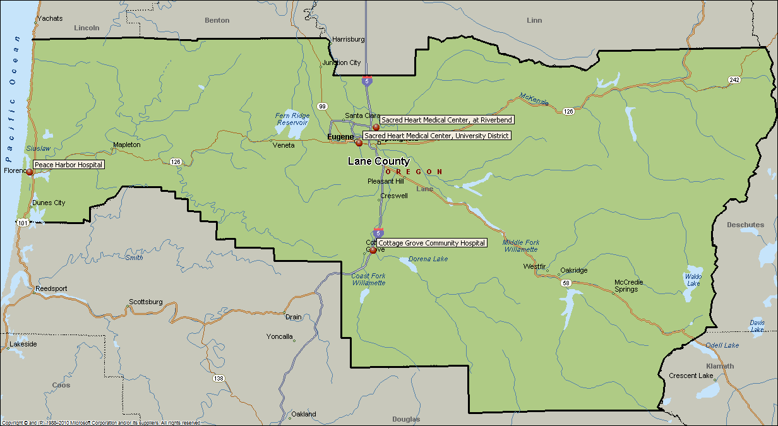
The “community” (or assessment focus area) is defined as all of Lane County.

Slide 4
Sample Secondary Data Sources | National, State & Local
2010 US Census
Healthy People 2020
CDC obesity data / maps
National Prevention Strategy, the National Prevention Council, June 2011
Oregon Healthy Teens 2007-2008 8th and 11th grade summarized
United Way of Lane County’s 2008 Leading Indicators Report
Lane Senior & Disabled Services, 2011 Community Needs Assessment
Oregon Tobacco Prevention and Education Program
County Health Rankings, 2012
Head Start of Lane County Community Assessment 2011-2012
National Vital Statistics Report (NVSR) Final Data for 2009
Healthy Air Survey, Lane County Public Health
Oregon Tobacco Facts and Laws
Prevent Obesity – Institute of Medicine
Oregon Student Wellness Survey
Lane County Housing tenant survey
Eugene Taskforce on homelessness

Slide 5
Primary Data: Community Engagement
Outreach to existing community groups
Rotary & other service groups
Social service organizations
Focus groups: United Way Community Conversations
Public forums
Public officials
County commissioners
City councils
School boards
Key stakeholder interviews
Surveys: Written and online

Slide 6
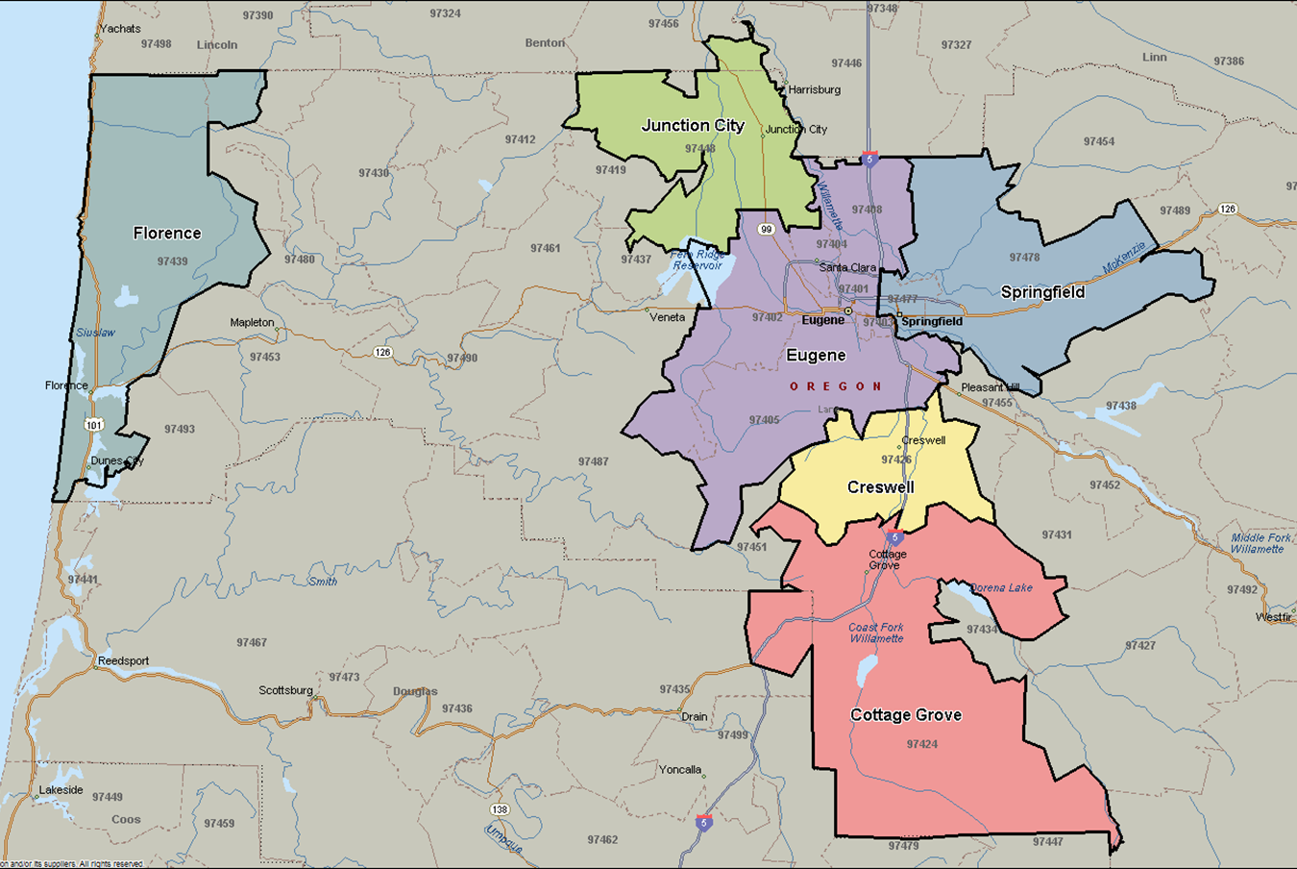
Poverty & Educational Attainment
13
12
19
15
40
20
13
21
17
28
28
12
17
14
16
Lane County
Oregon
12
Source: 2010 US Census
Percent with Bachelor’s Degree.
Percent of individuals whose income fell below the FPL at any point in the year.

Slide 7
Tobacco
Leading preventable cause of death and disease in Lane County – almost every chronic disease is either caused, or worsened, by tobacco
>700 die from tobacco each year (leading cause of death ~1/4 of all deaths);
nearly 14,000 suffer serious related illness each year
49,900 Lane County adults regularly smoke cigarettes (~1/5 adults). 7/10 want to quit
½ of all regular users who continue to smoke will die from tobacco use
Notes:
Cigarette butts are the number one item picked up on Oregon beaches. Although they look like paper, cigarette filters are made with acetate and do not decompose completely. Even more alarming, they contain toxic chemicals that leach into our water system.

Slide 8
Obesity
Notes:
Preventing obesity lowers the risk of diabetes, heart disease, stroke, high blood pressure, stress and depression and resulting health care costs
170,620 adults in Lane County (over 60%) are overweight (33.7%) or obese (26.5%) (Source: Oregon BRFSS County Combined Dataset 2008-2011)

Slide 9
Behavioral Health
Deaths per 100,000
Source: Lane County and Oregon Data from Oregon County Vital Statistics Book 2008; National Data from National Vital Statistics Report
Notes:
Rate of death due to alcohol-induced disease in Lane County is more than twice the national average
Local and state suicide rate is higher than the national average

Slide 10
Access to Care
10
Notes:
Phenomenal local, state and national changes are occurring in the area of “access to care” and it is Public Health’s job to work with payers, providers and other partners to ensure that associated resources are directed to most impactful efforts

Slide 11
Community Health Improvement Priorities
Health Equity
Tobacco
Obesity
Substance Abuse and Behavioral Health
Access to Health Care

Slide 13
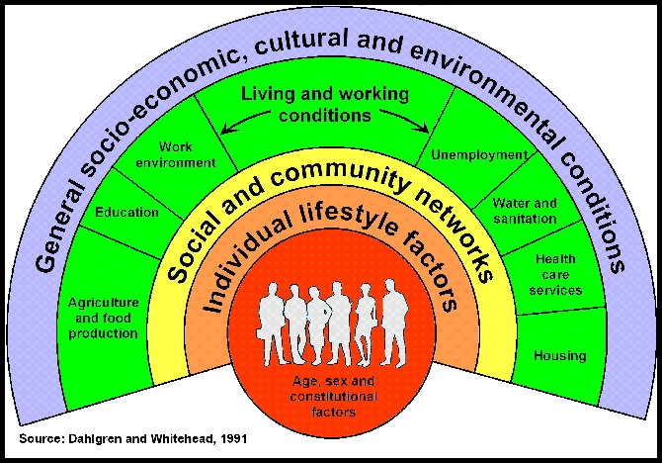
Social Determinants of Health
Notes:
The conditions in which people are born, grow, live, work and age.
Responsible for health inequities - the unfair and avoidable differences in health status seen within and between populations

Slide 14
Multi-Sector Partnerships – recent efforts
Recent local examples:
Health Impact Assessment of City of Eugene’s Climate and Energy Action Plan
Lane Livability Consortium
HIAP workshop today
Scenario planning to reduce local greenhouse gas emissions
LaneACT
HIA Grant
Notes:
Goal – advancing shared vision and integrated agenda

Slide 15
Health Equity – recent progress
Established a Community Health Improvement Plan Health Equity Workgroup
Developing more detailed workplan
Applying for a grant from the Oregon Health Authority to support the development of a Regional Health Equity Coalition to promote participation in local and statewide policy-making and policy implementation

Slide 16
Tobacco Prevention – recent progress
Protecting people from exposure to second hand smoke
University of Oregon
Housing and Community Services Agency of Lane County
Tobacco-free worksites in 2013
Planned Parenthood, United Way of Lane County,
Oregon Research Institute, Trillium Community Health
Plan
Tobacco Retail Licensing
Board of County Commissioners decision to explore licensing of tobacco retail outlets
Electronic Cigarettes
Many local school districts are enhancing their tobacco-free campus policies to include e-cigs
Promote the Oregon Tobacco Quitline (1-800-QUIT-NOW)

Slide 17
Obesity Prevention – recent progress
Public Health folks working to learn more about land use, transportation and economic development sectors policies and processes
Healthy worksite cafeterias and vending policies including limiting the sale of sugar sweetened beverages
Healthy meetings and events policies
Include healthy options
Incorporate physical activity breaks during long meetings
Healthy worksite infrastructure
Standing desks
Stairwell promotion campaigns

Slide 18
Mental Health Promotion – recent progress
Begun filming for a mental health first aid kit anti-stigma campaign
Recently convened a firearms safety initiative
Conducting provider and public education mental health first aid and suicide prevention trainings
Efforts to expand mental health-friendly worksite initiatives

Slide 19
Substance Abuse Prevention – recent progress
Binge drinking prevention campaign launched this fall
Expansion of prescription drop box site locations
Development of prescription registry
Substance abuse prevention coalition expanding beyond Eugene to Springfield
Whiteaker Brewery Taskforce established to prevent alcohol abuse in emerging “fermentation district”

Slide 20
Improving Access to Care – upcoming changes and recent progress
Expanded health care coverage for a ~500,000 Oregonians (projected move from 83% to 95% insured)
Local integration of physical, behavioral and oral health services
Completing resource assessment to prioritize needs and related strategies

Slide 21
Steps for Success
Close collaboration with community partners
Organizational infrastructure
Leadership
Accountability
Budget implications
Focus existing resources on community health priorities
Align community health with other improvement priorities
Identify new resources needed
Leverage external funding, e.g. grants

Slide 22
C
Lane County Community Health
Improvement Structure
Community Input
Needs Assessment
Schools
Business
Social Services
Government
Plan
Faith Communities
100% Access Coalition
Convene, Coordinate, Advise
Monitor & Report
Health Care
Health Objective Workgroup
Health Objective Workgroup
Health Objective Workgroup
Health Objective Workgroup
Health Objective Workgroup
Community Impact

Slide 23
We envision a future where everyone in Lane County is empowered to improve the lifelong health of all people in Lane County. - Lane County’s Healthy Future, A Community Health Improvement Plan for Lane County, Oregon

